Slide 1

Chapter 5：Line-Frequency Diode Rectifiers（工频二极管整流器）
5-1 Introduction
5-2 Single-phase half-wave rectifier
5-3 Single-Phase Diode Bridge Rectifiers
5-6 Three-Phase, Full-Bridge Rectifiers
5-7 Comparison of Single-Phase and Three-
Phase Rectifiers
5-8 Inrush Current and Over voltages at Turn-
on

Slide 2
知识点：
1、掌握单相桥式二极管整流电路的电路结构、工作原理、特性和输入电流波形分析方法 ；
2、掌握三相桥式二极管整流电路的电路结构、工作原理、特性和输入电流波形分析方法 。

Slide 3
5-1 Introduction
5-1-1 Rectifier
Power electronic systems, such as Switching dc power supplies, ac motor drives, dc servo drives generally get their power from the utility source (公用电源).
DC
|
DC
+
+
V_{d}
V_{o}
~
rectifier
-
-
DC
|
AC
The role of a rectifier is to convert ac power into dc power. ☆
+
V_{d}
M
-

Slide 4
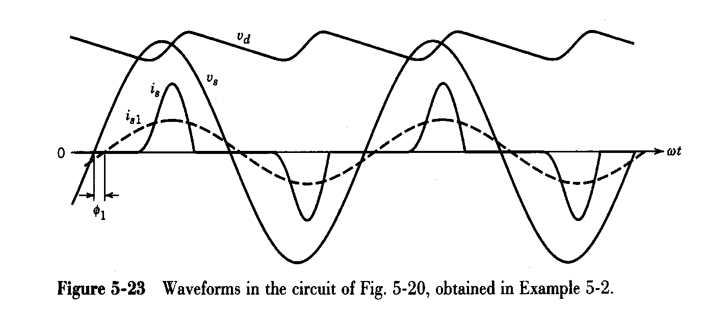
i_{d}
Diode rectifiers, the simplest and inexpensive rectifiers, commonly be used as their Front-Ends(前端、输入端).
i_{s}
v_{d}
v_{s}
Fig. 5-1 block diagram diode rectifier
Current i_{s} is highly distorted, which have a deleterious （有害的）effect on the power quality of the utility source.

Slide 5

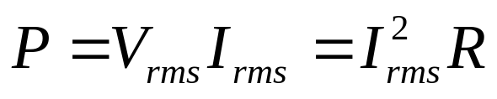
5-1-2 Performance Parameters (性能参数)
评价电能(电压、电流)质量的几个指标
To quantity distortion in the current i_{s} drawn by power electronic systems, it is necessary to define certain indices (指标). As a base case, we first consider linear load.
R_{wire}
Example 1:
Suppose we plug a resistor load into the wall socket. （墙壁插座）
Fuse
+
V
-
R
The fuse is rated for a specified rms current, above that, it will blow so that dissipation in R_{wire} does not start a fire.
With a 220V, 15A fuse, we get 3.3kW max. from wall socket (neglecting R_{wire} ).

Slide 6
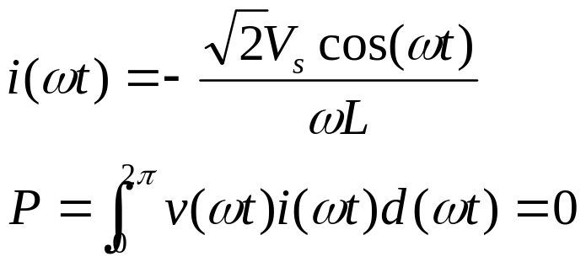
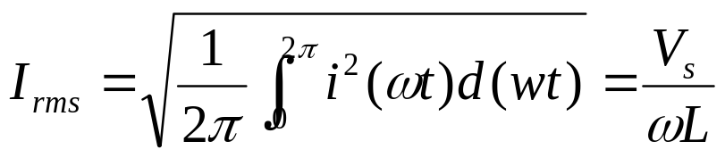
Example 2: Suppose instead we plug a inductor load into the wall socket.
R_{wire}
neglecting R_{wire}
Fuse
+
V
-
L
While we draw no real power, we still draw current.
220V, 50Hz, L=40mH→I_{rms}=17.5A >15A. So, the fuse will still blow (to protect the wall wire). In this case, we are not utilizing the source well.

Slide 7
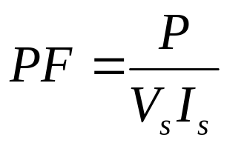
From example 1 and example 2, we can see that different load gets different utilization of the source.
1 Defining certain indices (指标).
(1) Defining the Power Factor (功率因数) ： a measure of the utilization of the source.
P---real average power (平均功率)
V_{s}I_{s}---apparent power (视在功率)
For the resistor PF=1, best utilization.
For the inductor, PF=0, worst utilization.

Slide 8
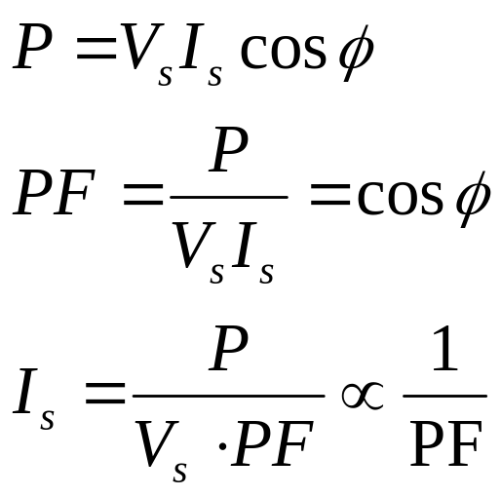
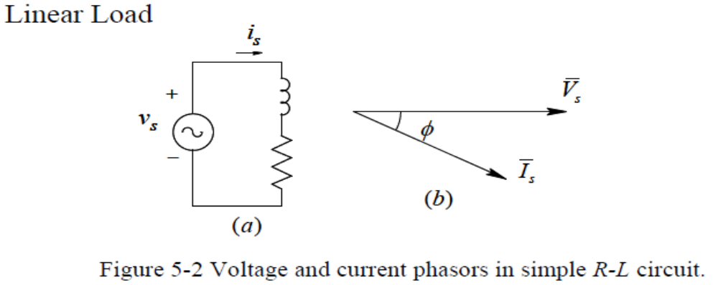
Linear Loads (线性负载): The sinusoidal current drawn by linear load has zero distortion.
I_{s} and PF are inversely proportional, unity power factor loads (单位功率因数负载) that draw power at the minimum rms current. ☆

Slide 9
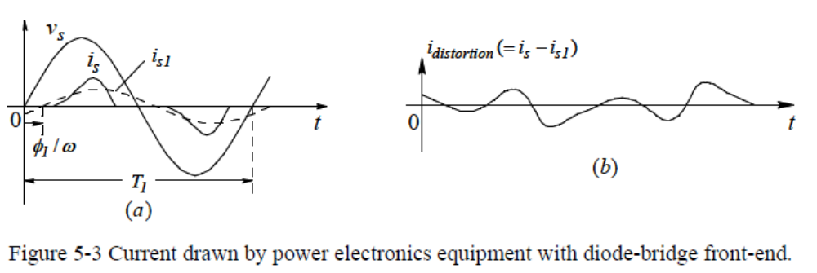
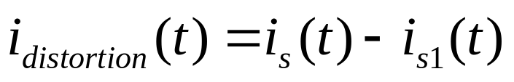
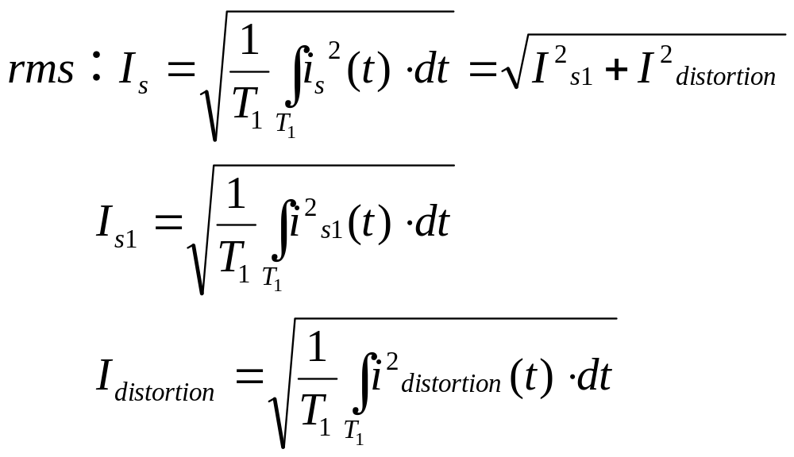
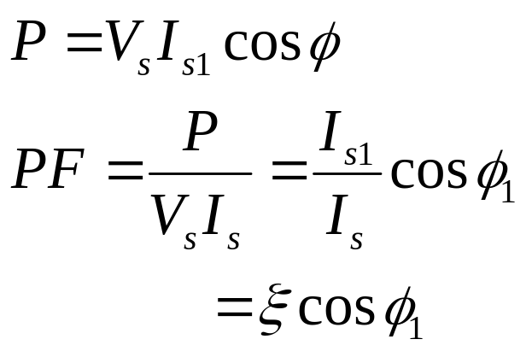
Nonlinear Loads（非线性负载）

Slide 10
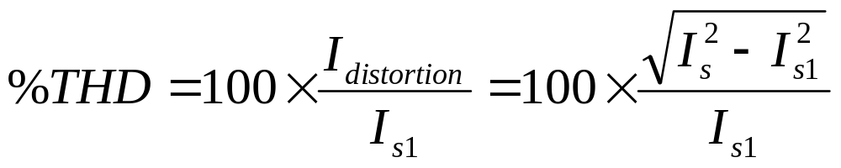
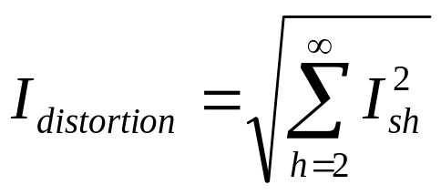
(2) Defining the Total Harmonic Distortion THD (谐波总畸变率) (or harmonic factor HF谐波因数): a measure of the distortion of a waveform.
i_{distortion}(t) consists of components at frequencies that are multiples of 1/T₁.
Where I_{sh} is the rms value of the harmonic component “h” .

Slide 11
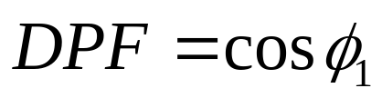
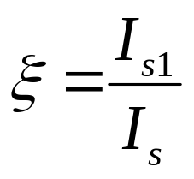
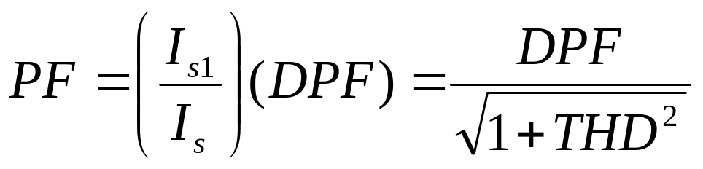
(3) Defining the Displacement Power Factor DPF (or Displacement Factor ) (基波功率因数、相位移因数)
(4) Defining the Distortion Factor (畸变因数)
Nonlinear loads reduce power factor. ☆

Slide 12
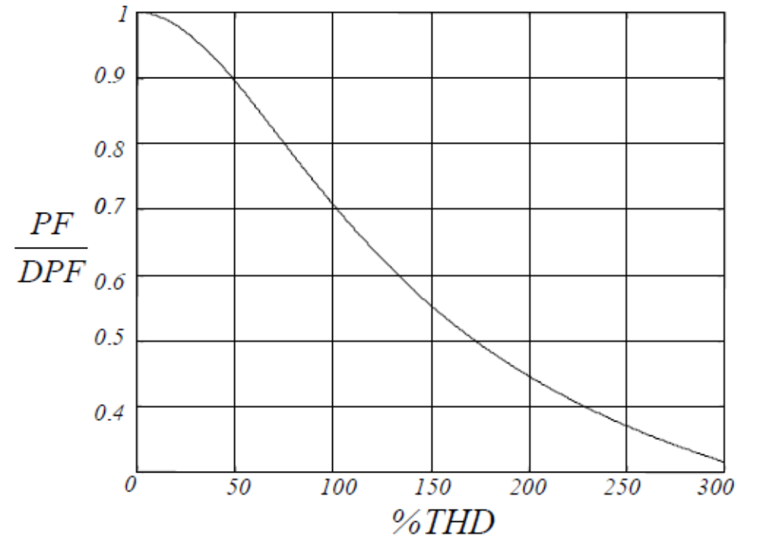
Harmonic Currents Lower Power Factor
Ratio of actual power factor to displacement power factor decreases with increasing THD

Slide 13
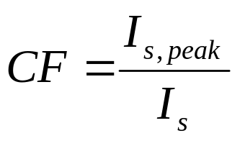
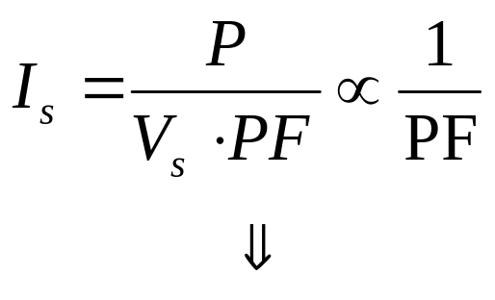
(5) Defining the Crest factor (峰值因数): a measure of the peak input current I_{s,peak} as compared with its rms value I_{s}.
I_{s,peak} ----the peak value of i_{s}.
2 Deleterious effects of poor power factor ☆
Increasing power loss in transmission lines, transformers, generators.

Slide 14
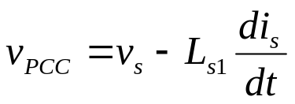
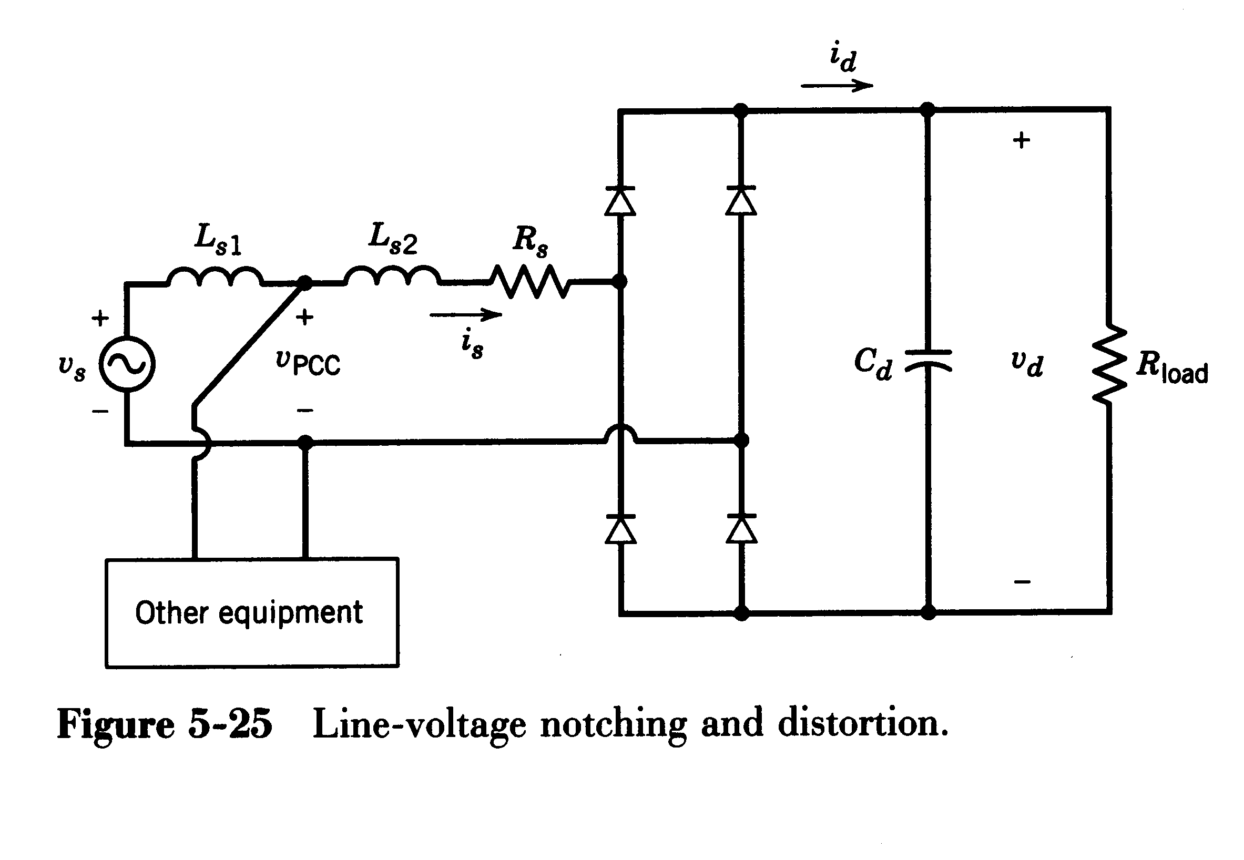
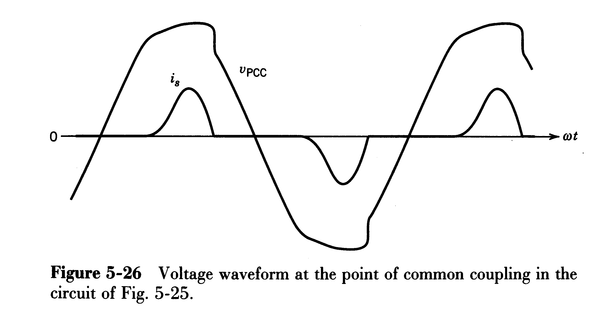
3 Deleterious effects of harmonic distortion ☆
Increasing power loss in transmission lines, transformers, generators.
The utility voltage waveform will also become distorted, adversely affecting other linear loads.

Slide 15
May causing resonance conditions between the capacitive reactance of the shunt capacitors and the inductive reactance of the transmission lines.
Overloading the shunt capacitors used by utilities for voltage support.
May causing EMI

Slide 16
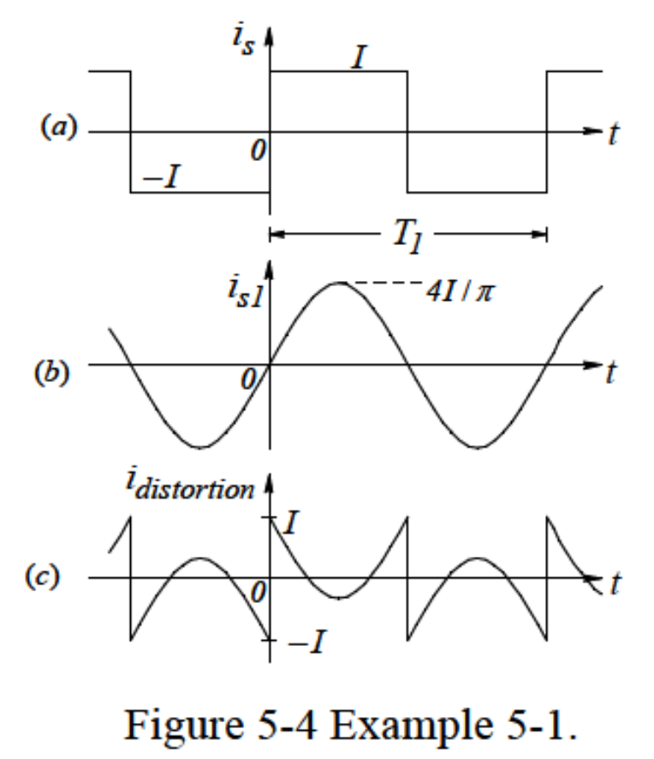
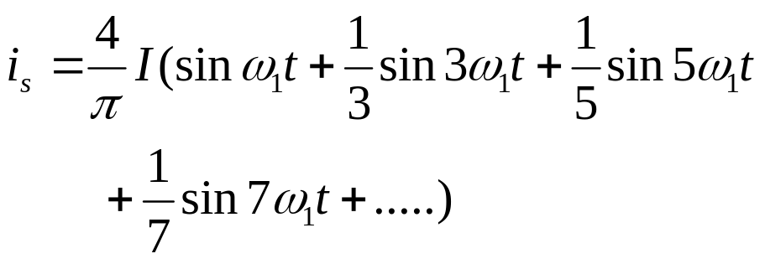
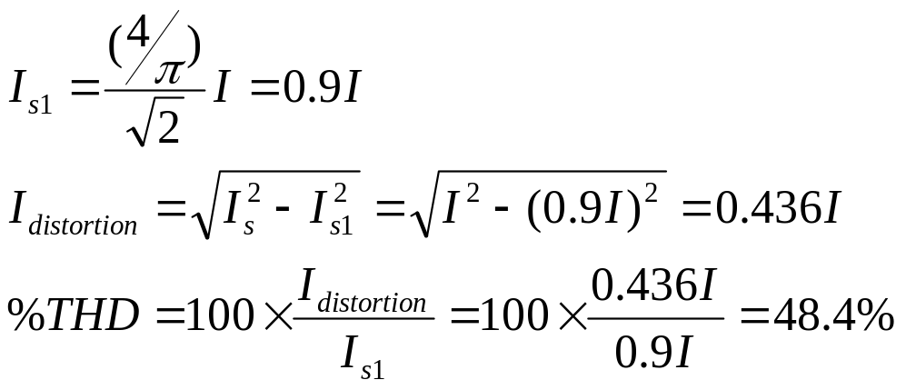
Example 5-A A current is of square waveform is shown in following Figure. Calculate and plot its fundamental frequency component and its distortion component. What is the THD associated with this waveform?
Solution: From Fourier analysis, By choosing the time origin as shown in Figure, i_{s}(t) can be expressed as:

Slide 17
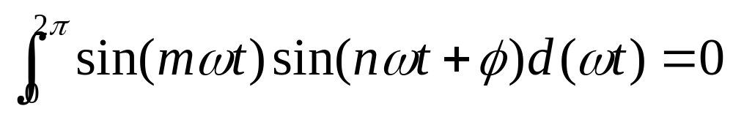
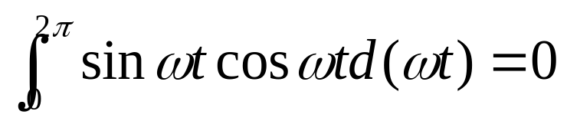
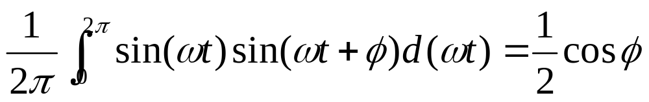
4 Important Calculating Equations
(1) Sinusoidals of different frequency are orthogonal.
If m≠n
(2) Sin. and cosine are orthogonal.
(3) In general
☆These Equations will be useful for calculating power, etc.

Slide 18
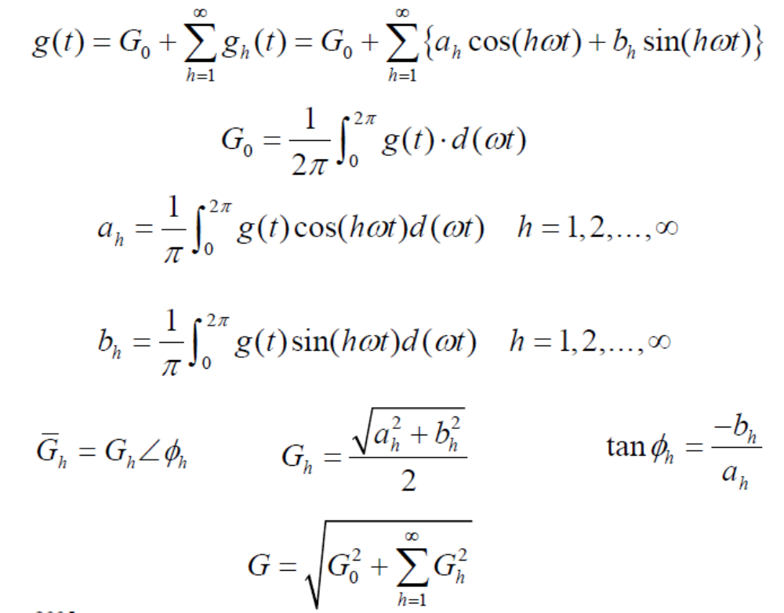
(4) Obtaining Harmonic Components by Fourier Analysis

Slide 19
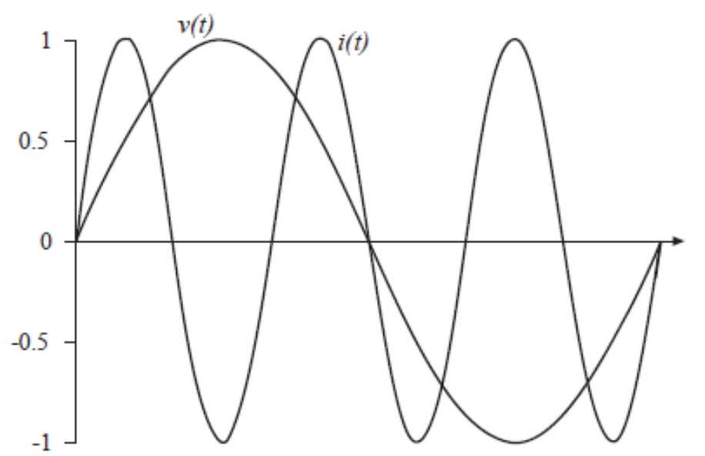
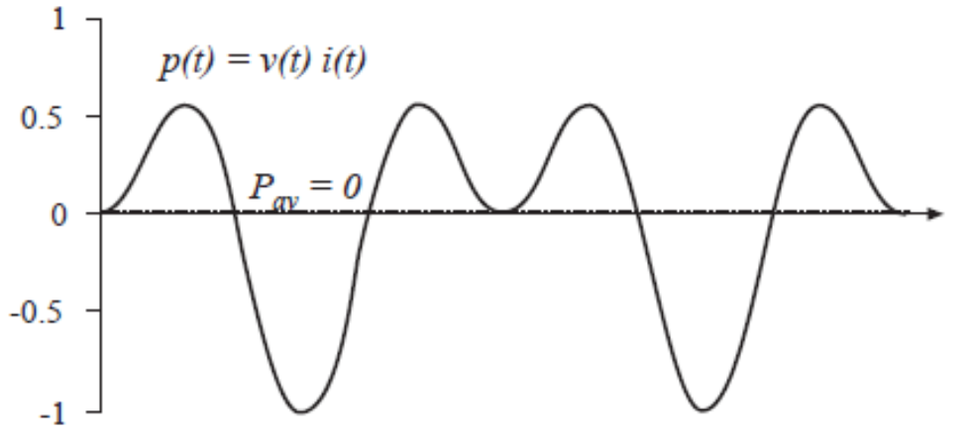
Example 1
Voltage: fundamental only
Current: third harmonic only
Power: zero average

Slide 20
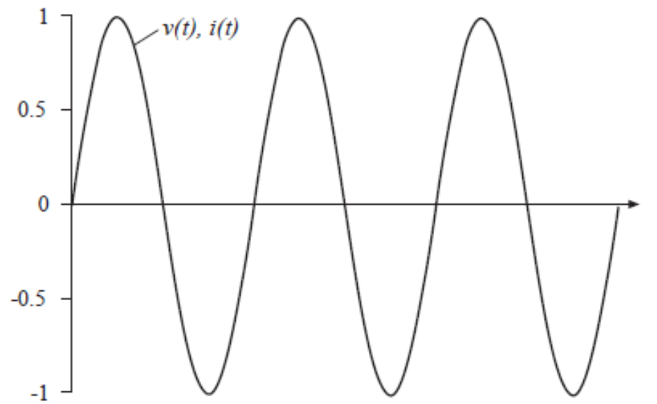
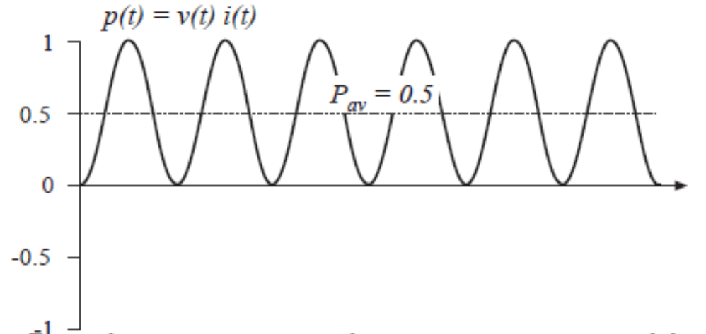
Example 2
Voltage: third harmonic only
Current: third harmonic only, in phase with voltage
Power: nonzero
average

Slide 21
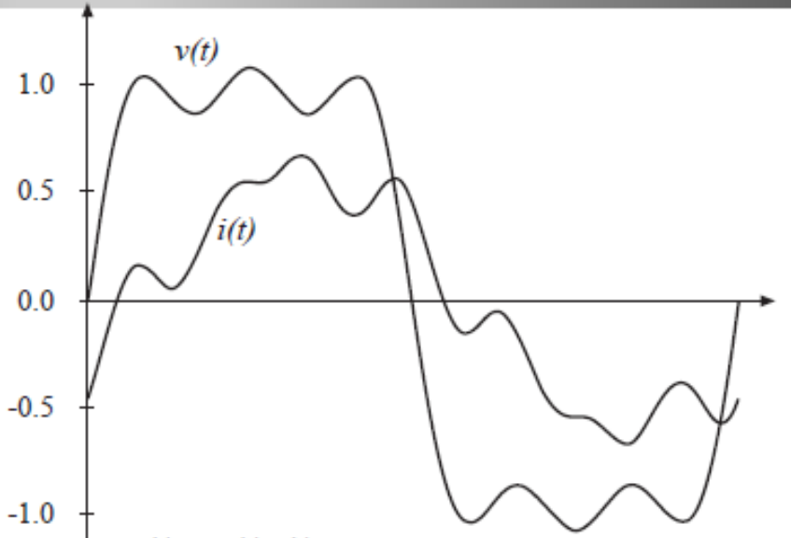
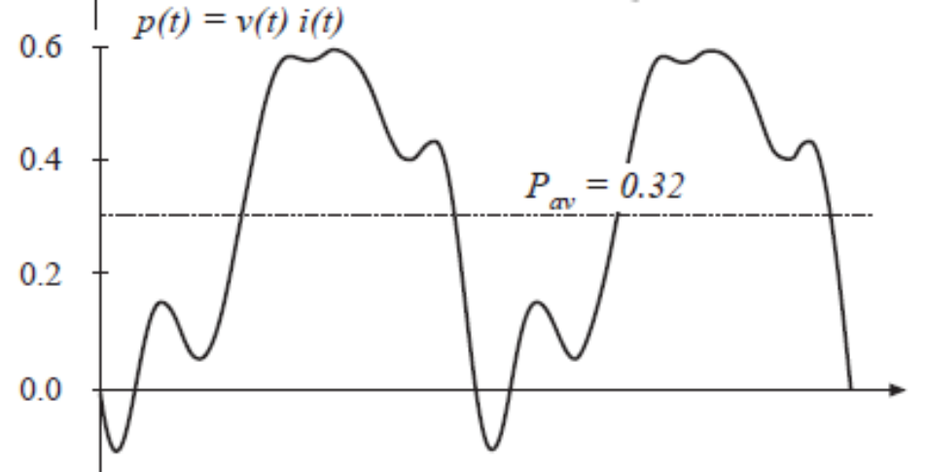
Example 3
Voltage: 1st, 3rd, 5th
Current: 1st, 5th, 7th
Power: net energy is transmitted at fundamental and fifth harmonic frequencies

Slide 22
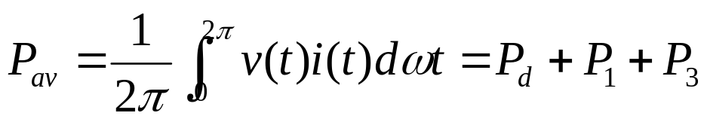
Example 5-B The voltage v across a load and the current i into the positive-polarity terminal are as follows (where ω₁ and ω₃ are not equal):
Calculate the following:
(a) The average power P supplied to the load
(b) The rms value of v(t) and i(t)
(c) The power factor at which the load is operating
Solution

Slide 23
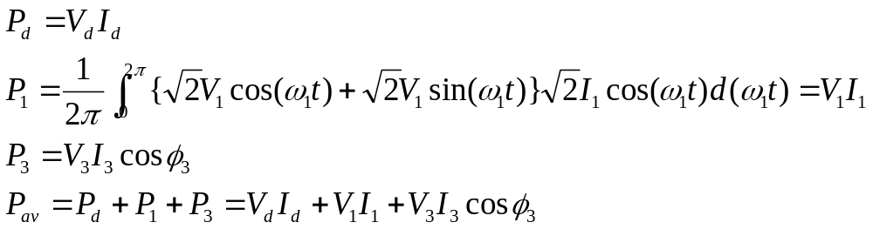
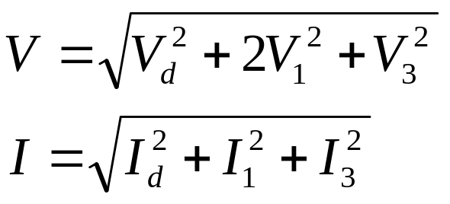
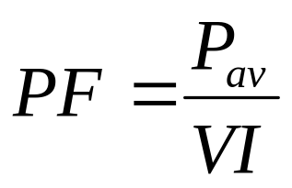
Solution

Slide 24
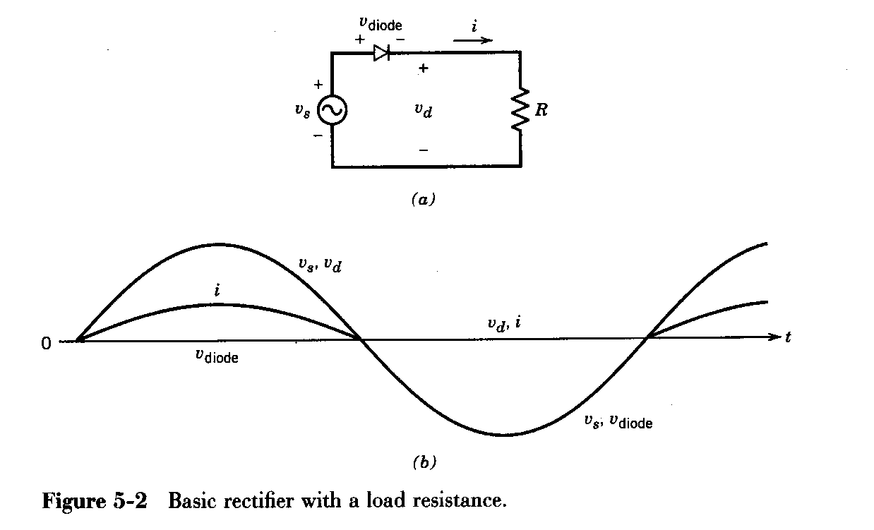
5-2 Single-phase half-wave rectifier （单相半波整流电路）
1 Pure resistive load:
During the positive half-cycle of the input voltage, D conducts and input voltage appears across the load. v_{d}=v_{s}, i=v/R.
During the negative half-cycle, D is a blocking condition and the load voltage is zero. v_{d}=0, i=0.
Because of the large ripple in v_{d} and i, this circuit is of little practical significance.

Slide 25
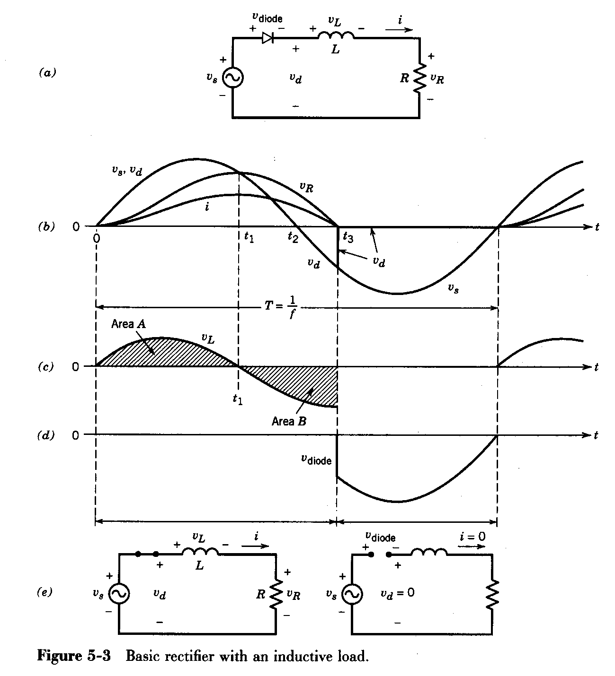
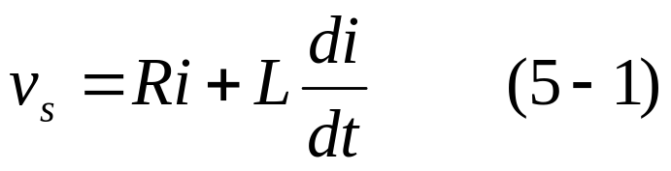
2 Inductive load
Subsequent to t=0, D becomes forward biased and a current begins flow.
In comparison to the case of purely resistive load, the average load voltage is less.

Slide 26
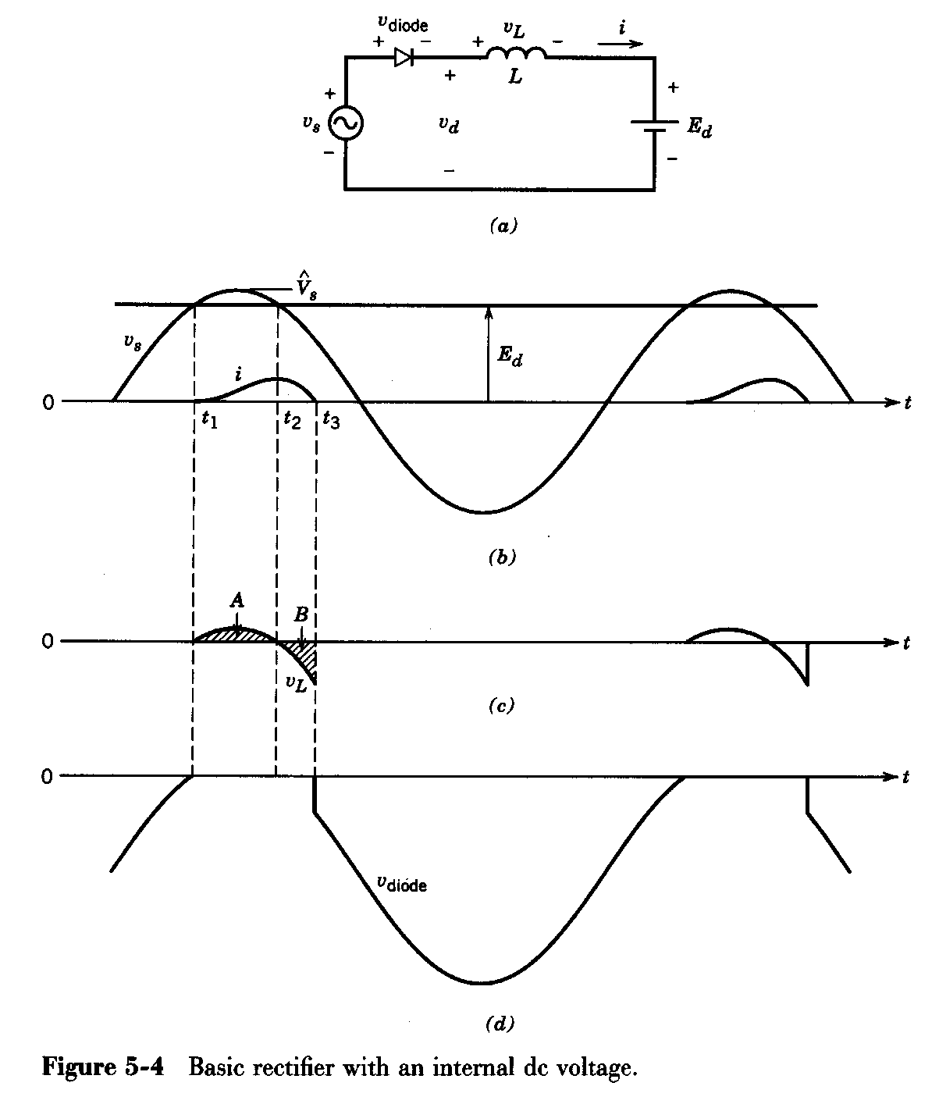
3 Load with an internal voltage
Current begins to flow when the input voltage exceeds the dc back-emf.
Current continues to flow for a while even after the input voltage has gone below the dc back-emf.

Slide 27
Supplements: Compare with different circuits and loads
Ac side currents waveforms of three basic load type (R/L/C) , especially type C;
Dc side voltage waveforms and amplitude of L choke（阻流电感）and C bank （电容器组）;
Effect of Ac side inductance (LS) on current communication;
Power quality terms of non-sinusoidal waveforms;
Protection of inrush current and overvoltage of rectifier at turn-on

Slide 28
Ac side currents and Dc side voltage waveforms of basic R load
1. Pure resistive load
Shape of current is the same as of voltage when diode is forward biased.
V_{s}
i_{s}
V_{d}
+ V_{diode} -
i_{s}
+
V_{s}
-
+
V_{d}
-
0
t
R
V_{diode}
i_{s}
+ V_{diode} -
+
V_{s}
V_{d}
V_{s}
i_{s}
t
-
+
V_{d}
-
0
+
R
V_{diode}
V_{s}
-
Because of the large ripple in vd and i, this circuit is of little practical significance.

Slide 29


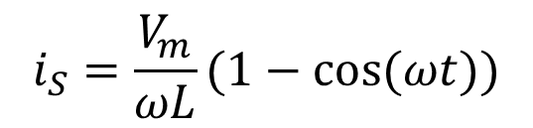
Ac side currents and DC side voltage waveforms of L load
2. Inductive load
+ V_{diode} -
i_{s}
i_{s}
+ V_{diode} -
L
+
V_{s}
-
+
V_{d}
-
+
V_{s}
-
+
V_{d}
-
L
R
V_{s}
V_{d}
V_{s}
i_{s}
V_{d}
i_{s}
V_{diode}
0
t
0
V_{diode}
t

Slide 30
Ac side currents and DC side voltage waveforms of L load
2. Inductive load
V_{s}
V_{d}
i_{s}
+ V_{diode} -
L
+
i_{s}
V_{s}
-
+
V_{d}
-
0
+
t
V_{s}
-
V_{diode}

Slide 31
Ac side current and Dc side voltage waveforms of basic C load
3. Capacitive load
i_{s}
+ V_{diode} -
+
V_{s}
-
+
V_{d}
-
V_{d}
+
V_{s}
V_{s}
i_{s}
-
0
t
i
i_{s}
+ V_{diode} -
0
t
+
V_{diode}
V_{s}
-
+
V_{d}
-
+
R
V_{s}
C
-

Slide 32
Ac side current and Dc side voltage waveforms of basic R-L load
i_{s}
+ V_{diode} -
+ V_{L} -
4. Resistive and Inductive load
+
V_{s}
-
L
+
V_{d}
-
+
V_{R}
-
R
Subsequent to t=0, D becomes forward biased and a current begins flow.
V_{s}
i_{s}
t₂
0
t
t₁
V_{R}
0
t
Area A
V_{L}
V_{d}
+ V_{L} -
i
+ V_{diode} -
i=0
0
t
L
t₁
+
V_{s}
-
+
V_{d}
-
+
V_{R}
-
+
V_{s}
-
+
V_{d}=0
-
R
Area B
0
t
V_{diode}

Slide 33
Ac side current and Dc side voltage waveforms of basic R-L load
V_{s}
4. Resistive and Inductive load
i_{s}
0
t
V_{d}
V_{s}
i_{s}
+ V_{diode} -
V_{R}
0
t
+
V_{s}
-
+
V_{d}
-
L
Area A
V_{L}
R
0
t
Area B
0
t
V_{diode}

Slide 34
Ac side current and Dc side voltage waveforms of basic L-Ed load
5. Load with an internal voltage
i_{s}
+ V_{diode} -
+ V_{L} -
+
V_{s}
-
L
+
E_{d}
-
+
V_{d}
-
Current begins to flow when the input voltage exceeds the dc back-emf.
Current continues to flows for a while even after the input voltage has gone below the dc back-emf.
V_{d}
V_{s}
i_{s}
E_{d}
0
t
t₁
t₂
t₃
A
B
0
t
V_{L}
0
t
V_{diode}

Slide 35
Ac side current and Dc side voltage waveforms of basic L-Ed load
5. Load with an internal voltage
V_{d}
i_{s}
+ V_{diode} -
L
V_{s}
E_{d}
+
V_{s}
-
+
V_{d}
-
0
t
+
E_{d}
-
t₁
t₂
t₃
i_{s}
0
t
0
t
V_{diode}

Slide 36
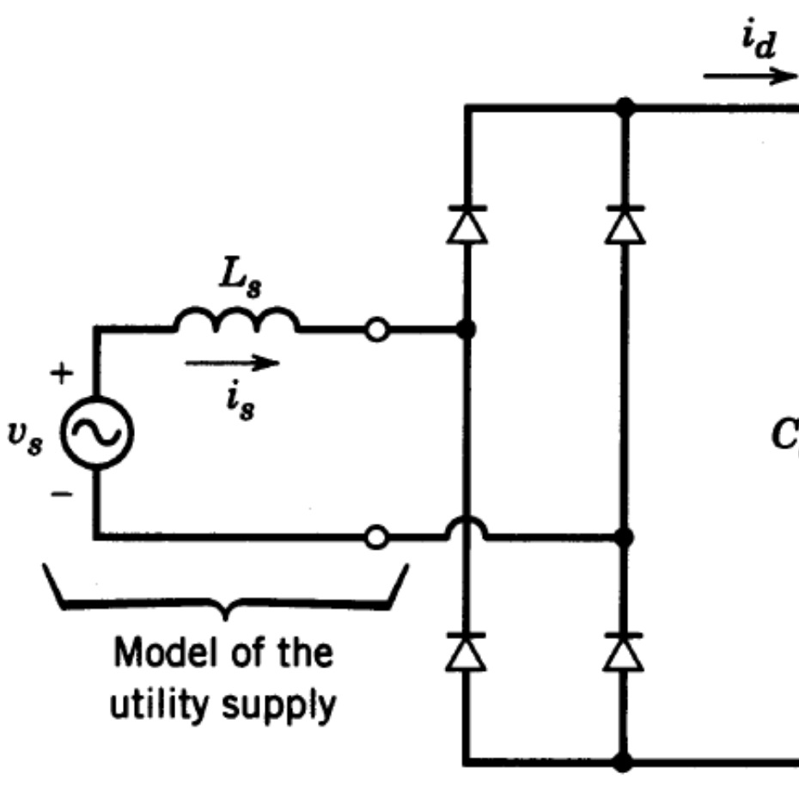
5-3 Single-Phase Diode Bridge Rectifiers（单相二极管桥式整流电路）
L_{s} is the sum of the inductance internal to the utility supply and an external inductance (for improving the line-current waveform).
+
V_{d}
-
Figure 5-5 Single-phase diode bridge

Slide 37
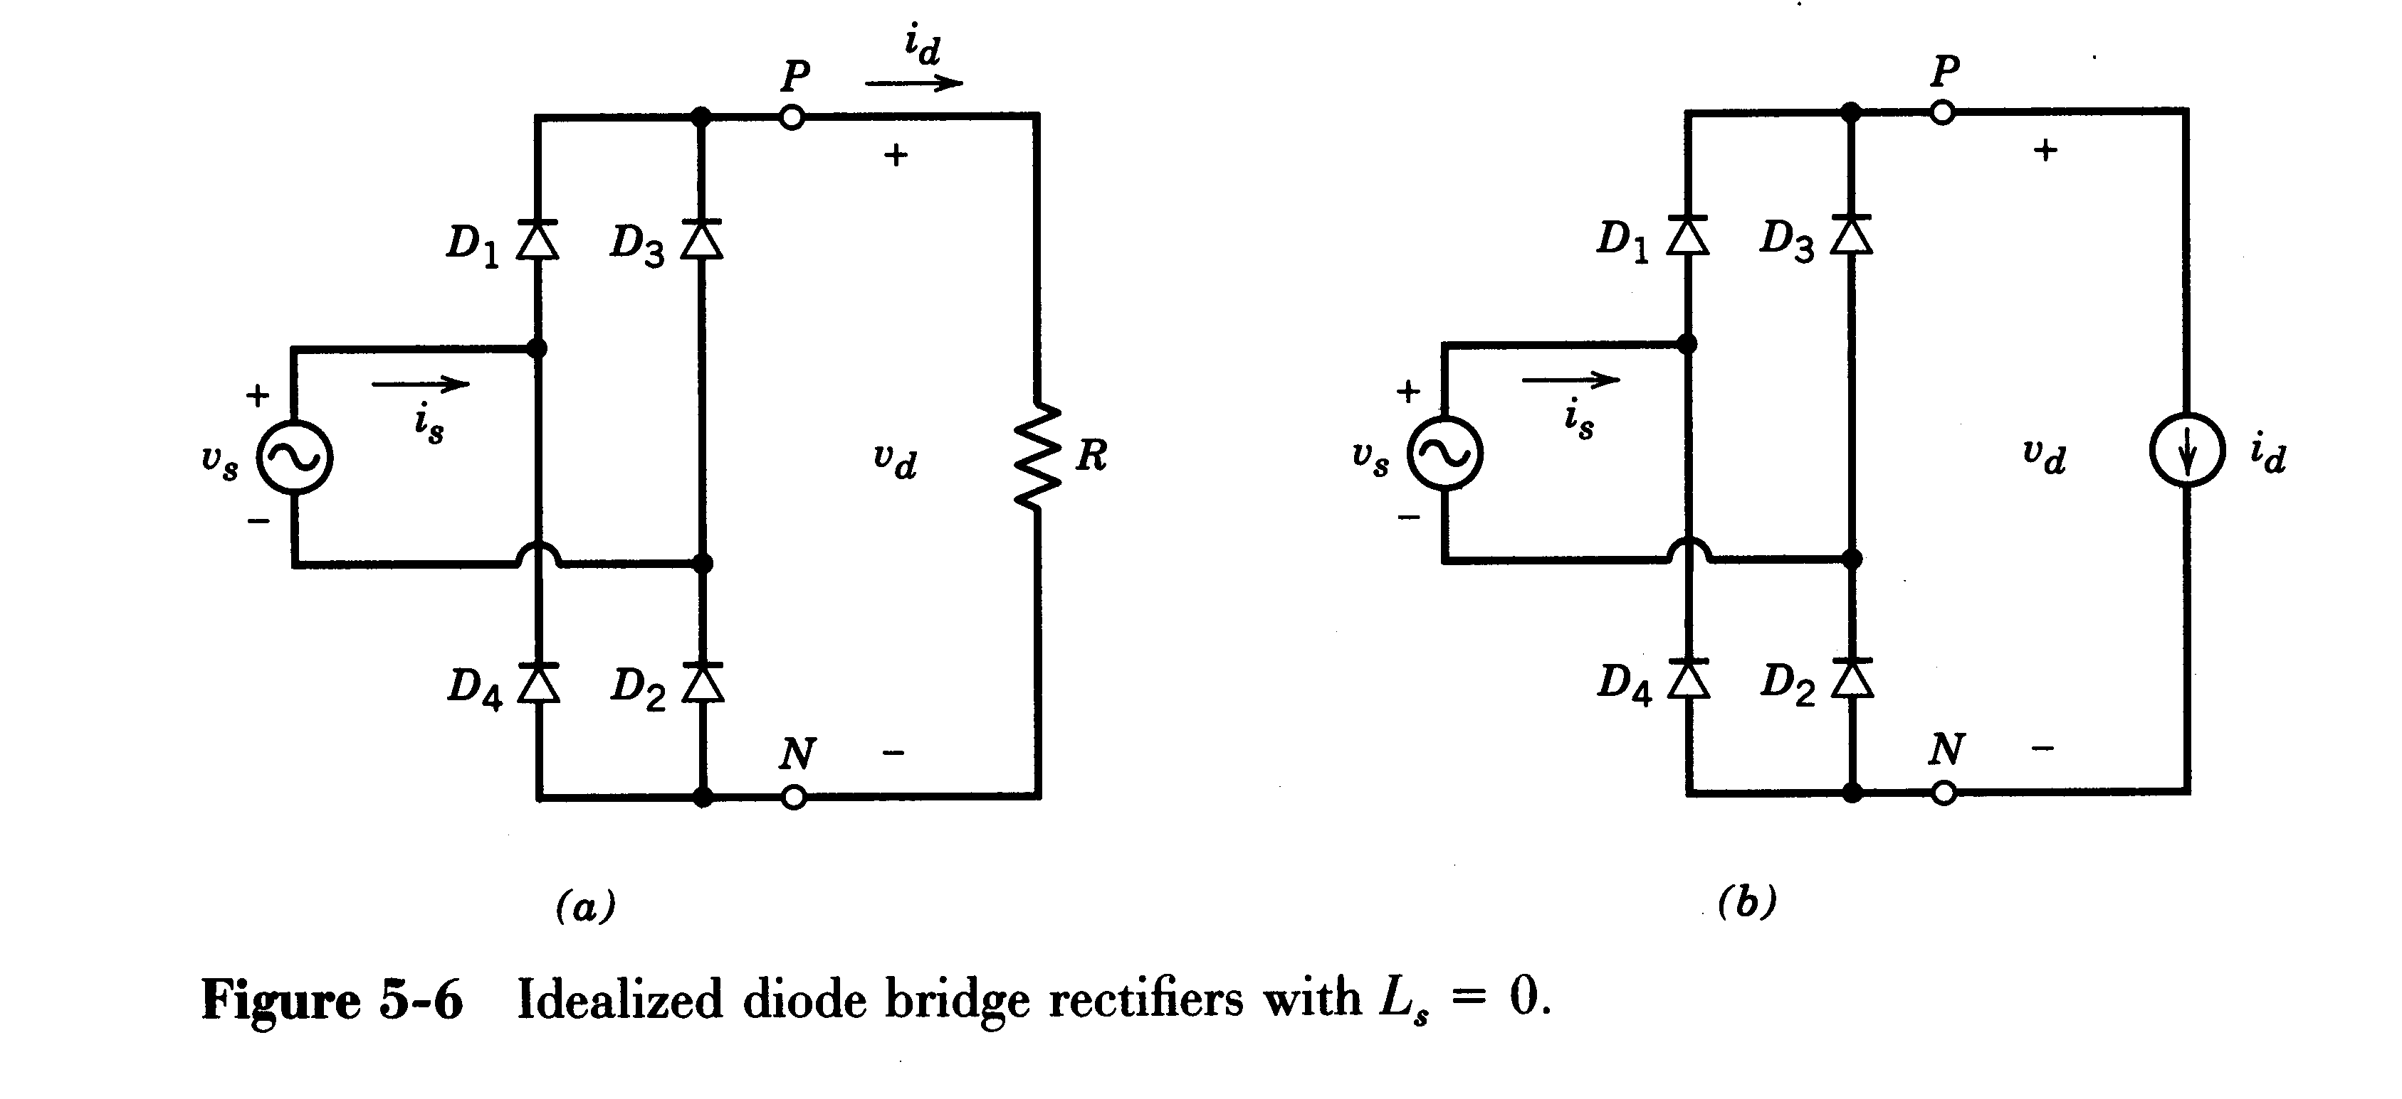
5-3-1 Idealized circuit with L_{s}=0
Rectifier model with a purely resistive load
Rectifier model with large inductor load (R-L load), the inductor current can be considered constant.

Slide 38
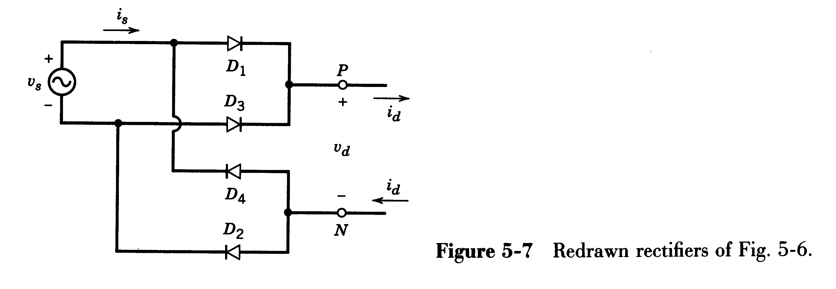
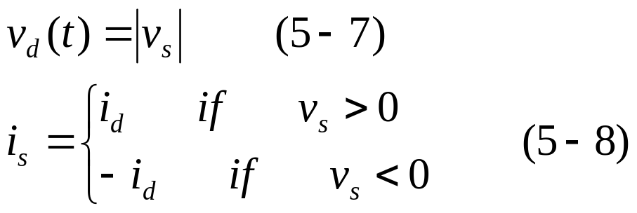
Note: In both circuits,
when v_{s} is positive, D₁ and D₂ conduct and v_{d}=v_{s} and i_{s}=i_{d};
when v_{s} goes negative, D₃ and D₄ conduct and v_{d}=-v_{s} and i_{s}=-i_{d}. Therefore,

Slide 39
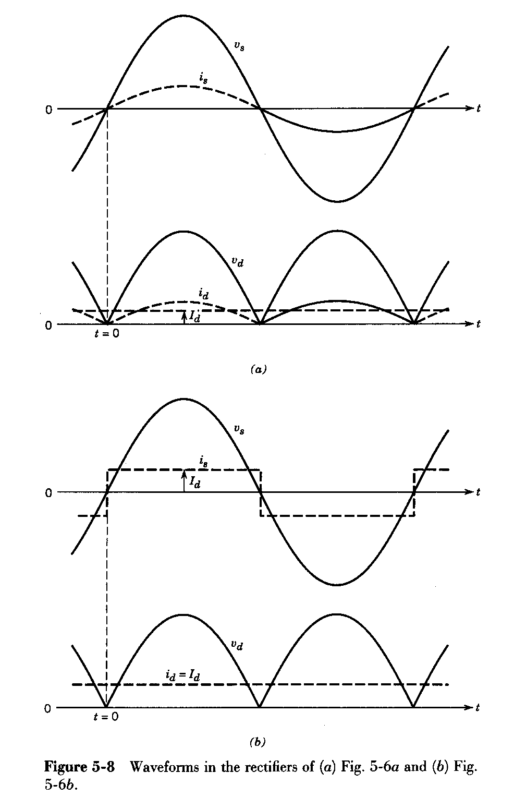
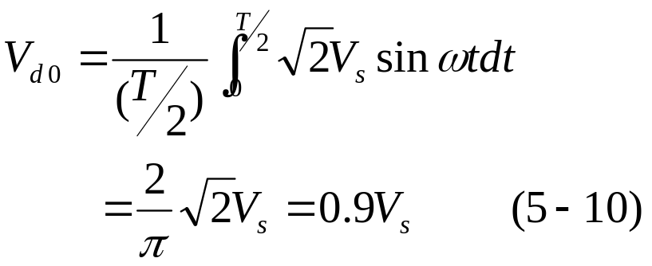
In both cases, the dc-side voltage waveform is the same

Slide 40
In both cases, the ac-side current waveform is different
Current commutation (换相) is finished instantaneously due to the assumption of zero L_{s}

Slide 41


Diode-Rectifier with large inductor load

Slide 42


Slide 43

5-3-2 Effect of L_{s} on Current Commutation
In the condition of dc-current i_{d} flows continuous.
Previously, we assume that the ac-side inductance L_{s}=0, so the current commutation is finished instantaneously. Now we consider the existence of L_{s}. In such case, the input current needs a finite amount of time to reverse its direction.

Slide 44

1 Current Commutation Process (换相过程):
Prior to ωt=0, D₃ and D₄ conduct, i_{s}=-I_{d}.

Slide 45
When ωt>0, D₁/D₂ become forward biased and therefore conduct. However, with a finite L_{s}, the current through them doesn’t jump instantaneously, and D₃/D₄ remain conducting mode for a short interval called the commutation (overlap) angle (换相重叠角) µ, thus resulting in v_{d}=0 and applying v_{s} across L_{s}.

Slide 46



During the commutation interval µ:
Circulating current (环流) i_{µ}: from 0 →I_{d}
At ωt=µ,
Figure 5-15 Redrawn circuit of Fig. 5-14a during current commutation.

Slide 47


2 Calculating commutation voltage-integral (换相电压积分):
The effect of the overlap is to reduce the average output voltage of converters. ☆

Slide 48

3 Calculating commutation angle μ (or γ).
During the commutation interval, v_{L}=v_{s}, therefore:
Commutation angle µ increase with L_{s} and I_{d} increasing and decrease with voltage V_{s} increasing. ☆

Slide 49


4 Calculating voltage drop (换相压降)ΔV_{d}.
Voltage drop ΔV_{d} increase with L_{s} and I_{d} increasing. ☆
Note: voltage drop in the presence of L_{s} doesn’t mean a power loss in L_{s}; it simply means a reduction in the voltage available on the dc-side.

Slide 50

Example 5-C Consider the basic commutation circuit as follow with I_{d}=10A.
(a) With V_{s}=120V at 60Hz and L_{s}=0, calculate V_{d} and the average power P_{d}.
(b) With V_{s}=120V at 60Hz and L_{s}=5mH, calculate µ, V_{d}, and P_{d}.
(c) Here v_{s} has a 60Hz square waveform with an amplitude of 200V, and L_{s}=5mH. Plot its waveform and calculate µ, V_{d}, and P_{d}.

Slide 51


Solution
Waveforms assume L_{s}=0

Slide 52



Solution

Slide 53

Solution
200V
µ
V_{d}
2π
10A
i_{s}

Slide 54

5-3-3 Rectifier with a dc-side voltage v_{d}(t)=V_{d}
When v_{s} exceeds V_{d} at θ_{b}, D₁/D₂ begin to conduct. The current reaches its peak at θ_{p}, beyond which v_{L} becomes negative. The current becomes zero at θ_{f} and remains zero until π+ θ_{b}.

Slide 55


With a given V_{d}, I_{d} can be calculated as follows:

Slide 56

Obviously, for given circuit parameters I_{d} will depend on V_{d} and vice versa.

Slide 57


5-3-3-1 Rectifier Characteristic ☆
1 DC-Side Voltage V_{d} and Current I_{d} Relationship:
V_{d}↑→I_{d}/I_{shortcircuit}↓
Defining:
Zero current corresponds to dc voltage equal to the peak of
the input ac voltage

Slide 58

2 Effect of DC-Side Current on THD, PF and DPF :
I_{d}/I_{shortcircuit} ↓→THD↑and PF↓
Very high THD and low power factor at low current values. ☆

Slide 59

3 Crest Factor versus the Current Loading:
I_{d}/I_{shortcircuit} ↓→CF↑
The Crest Factor is very high at low values of current. ☆

Slide 60

Increasing L_{s} results in improved i_{s} waveform with a lower THD, a better power factor and a lower crest factor. ☆

Slide 61

5-3-4 Diode-Rectifier with a Capacitor Filter ☆
R_{s} represents ac side losses.
Equivalent resistance R_{load} represents dc side load.
Conclusions about Rectifier Characteristics in Rectifier with a dc-side voltage are suitable for this condition.

Slide 62

1 Line-Current Distortion
Analysis using PSpice

Slide 63

Current pulses widen as L_{s} is increased, and therefore improved i_{s} waveform with a lower THD, a better power factor and a lower crest factor. ☆
→sometimes, an external inductor L_{s} must be introduced to improved i_{s} waveform.

Slide 64
The effect of introduce an external L_{s} on the characteristics of diode rectifier with a capacitor: ☆
  The power factor is improved from very poor to somewhat acceptable.
  Harmonics are decreased.
  The output voltage V_{d} is lower compared with the no-inductance case.
  The overall energy efficiency remains essentially the same; there are additional losses in the inductor, but the conduction losses in the diodes are lower.

Slide 65

Some other conclusions: ☆
  Only odd order harmonics exist in single-phase circuit.
  Magnitude of harmonics decreases as harmonic order increases.
  Harmonics increases and power factor decreases as capacitor increases.
  (Harmonics decreases and power factor increases as inductor L_{s} increases).

Slide 66

2 Line-Voltage Distortion
Distorted currents drawn by loads can result in distortion in utility voltage waveform.
Distortion in voltage supplied to other loads.

